Slide 1
Set-if-Less-Than (slt) instruction
Set result to 1 if a condition is true
Otherwise, set to 0
slt rd, rs, rt
if (R[$rs] < R[$rt]) R[$rd] = 1; else R[$rd] = 0;
slti rd, rs, constant
if (R[$rs] < constant) R[$rd] = 1; else R[$rd] = 0;
Use in combination with beq, bne
slt $s0, $s3, $s4 # if (R[$s3] < R[$s4]) bne $s0, $zero, Target # branch to Target

Slide 2
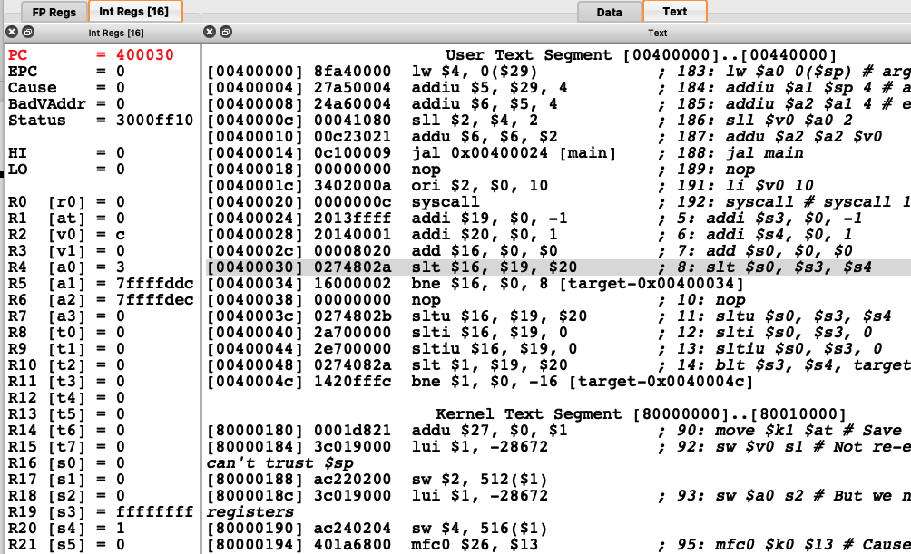

Slide 3
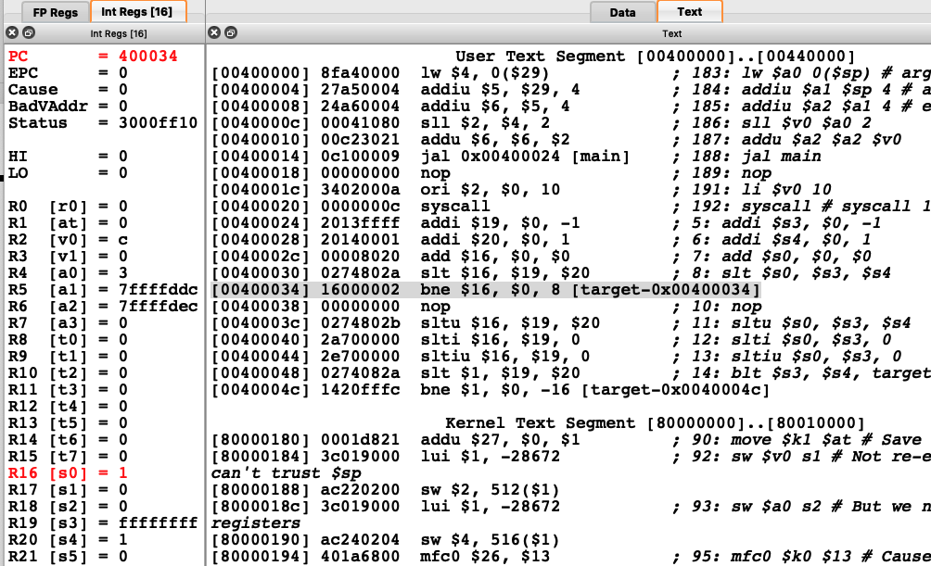

Slide 4
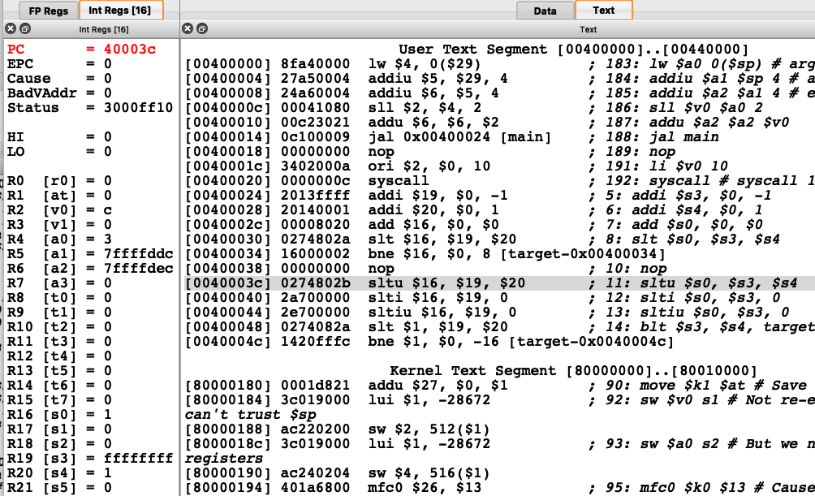

Slide 5
Signed vs. Unsigned slt
Signed comparison: slt, slti
Unsigned comparison: sltu, sltiu
Example
$s3 = 1111 1111 1111 1111 1111 1111 1111 1111
$s4 = 0000 0000 0000 0000 0000 0000 0000 0001
slt $s0, $s3, $s4 # signed
–1 < +1 ⇒ R[$s0] = 1
sltu $s0, $s3, $s4 # unsigned
+4,294,967,295 > +1 ⇒ R[$s0] = 0

Slide 6
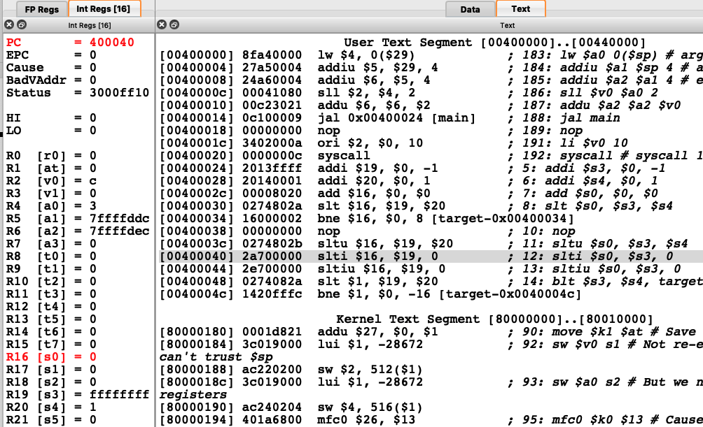

Slide 7
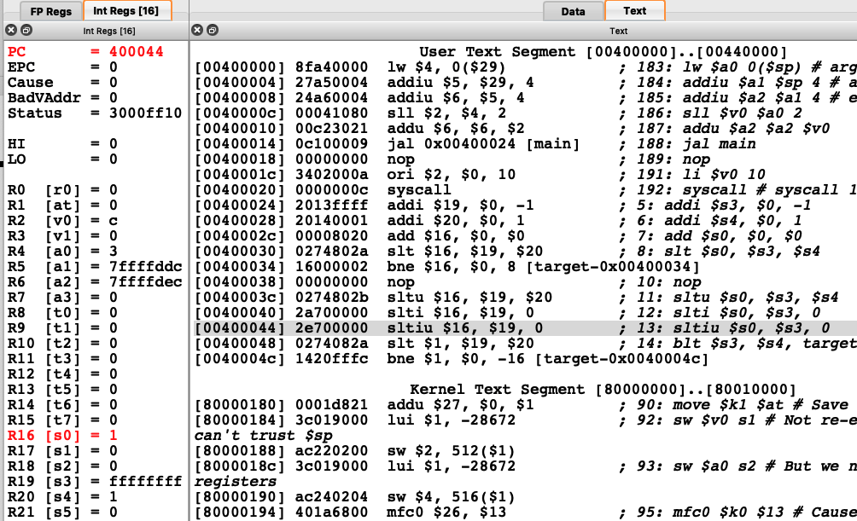

Slide 8
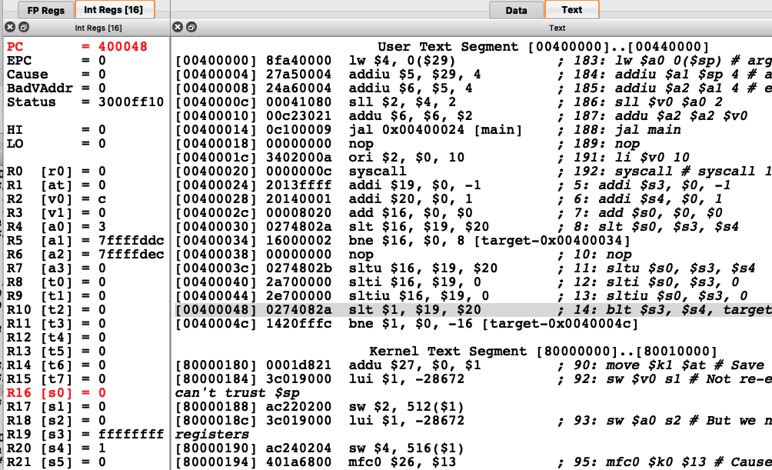

Slide 9
blt : pseudoinstruction
Why not blt, bge, etc?
Hardware for <, ≥, … slower than =, ≠
Combining with branch involves more work per instruction, requiring a slower clock
All instructions penalized!
beq and bne are the common case
This is a good design compromise

Slide 10
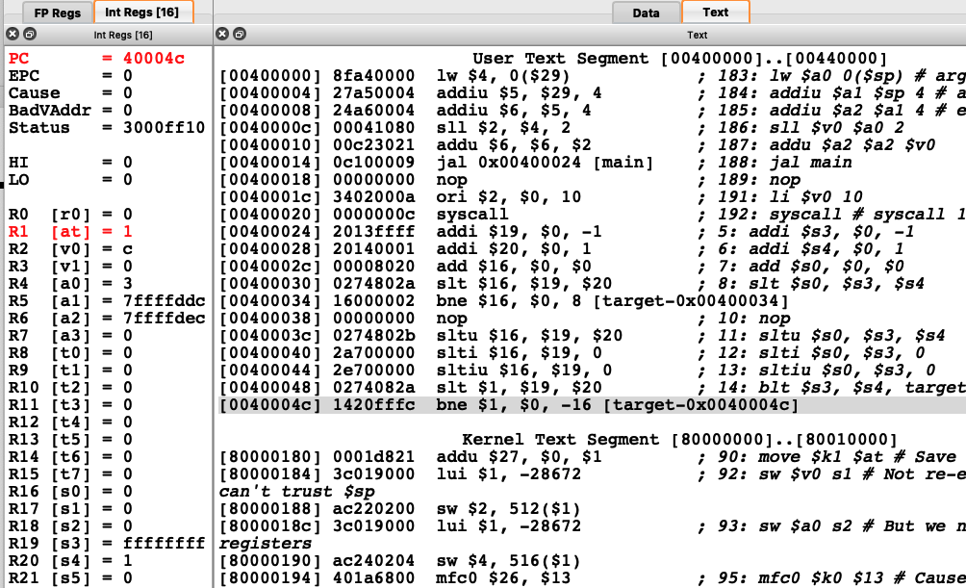

Slide 11


Slide 12
slt/sltu : R-format instruction
slt $16, $19, $20
000000 10011 10100 10000 00000 101010
0000 0010 0111 0100 1000 0000 0010 1010
= 0x0274802A

Slide 13
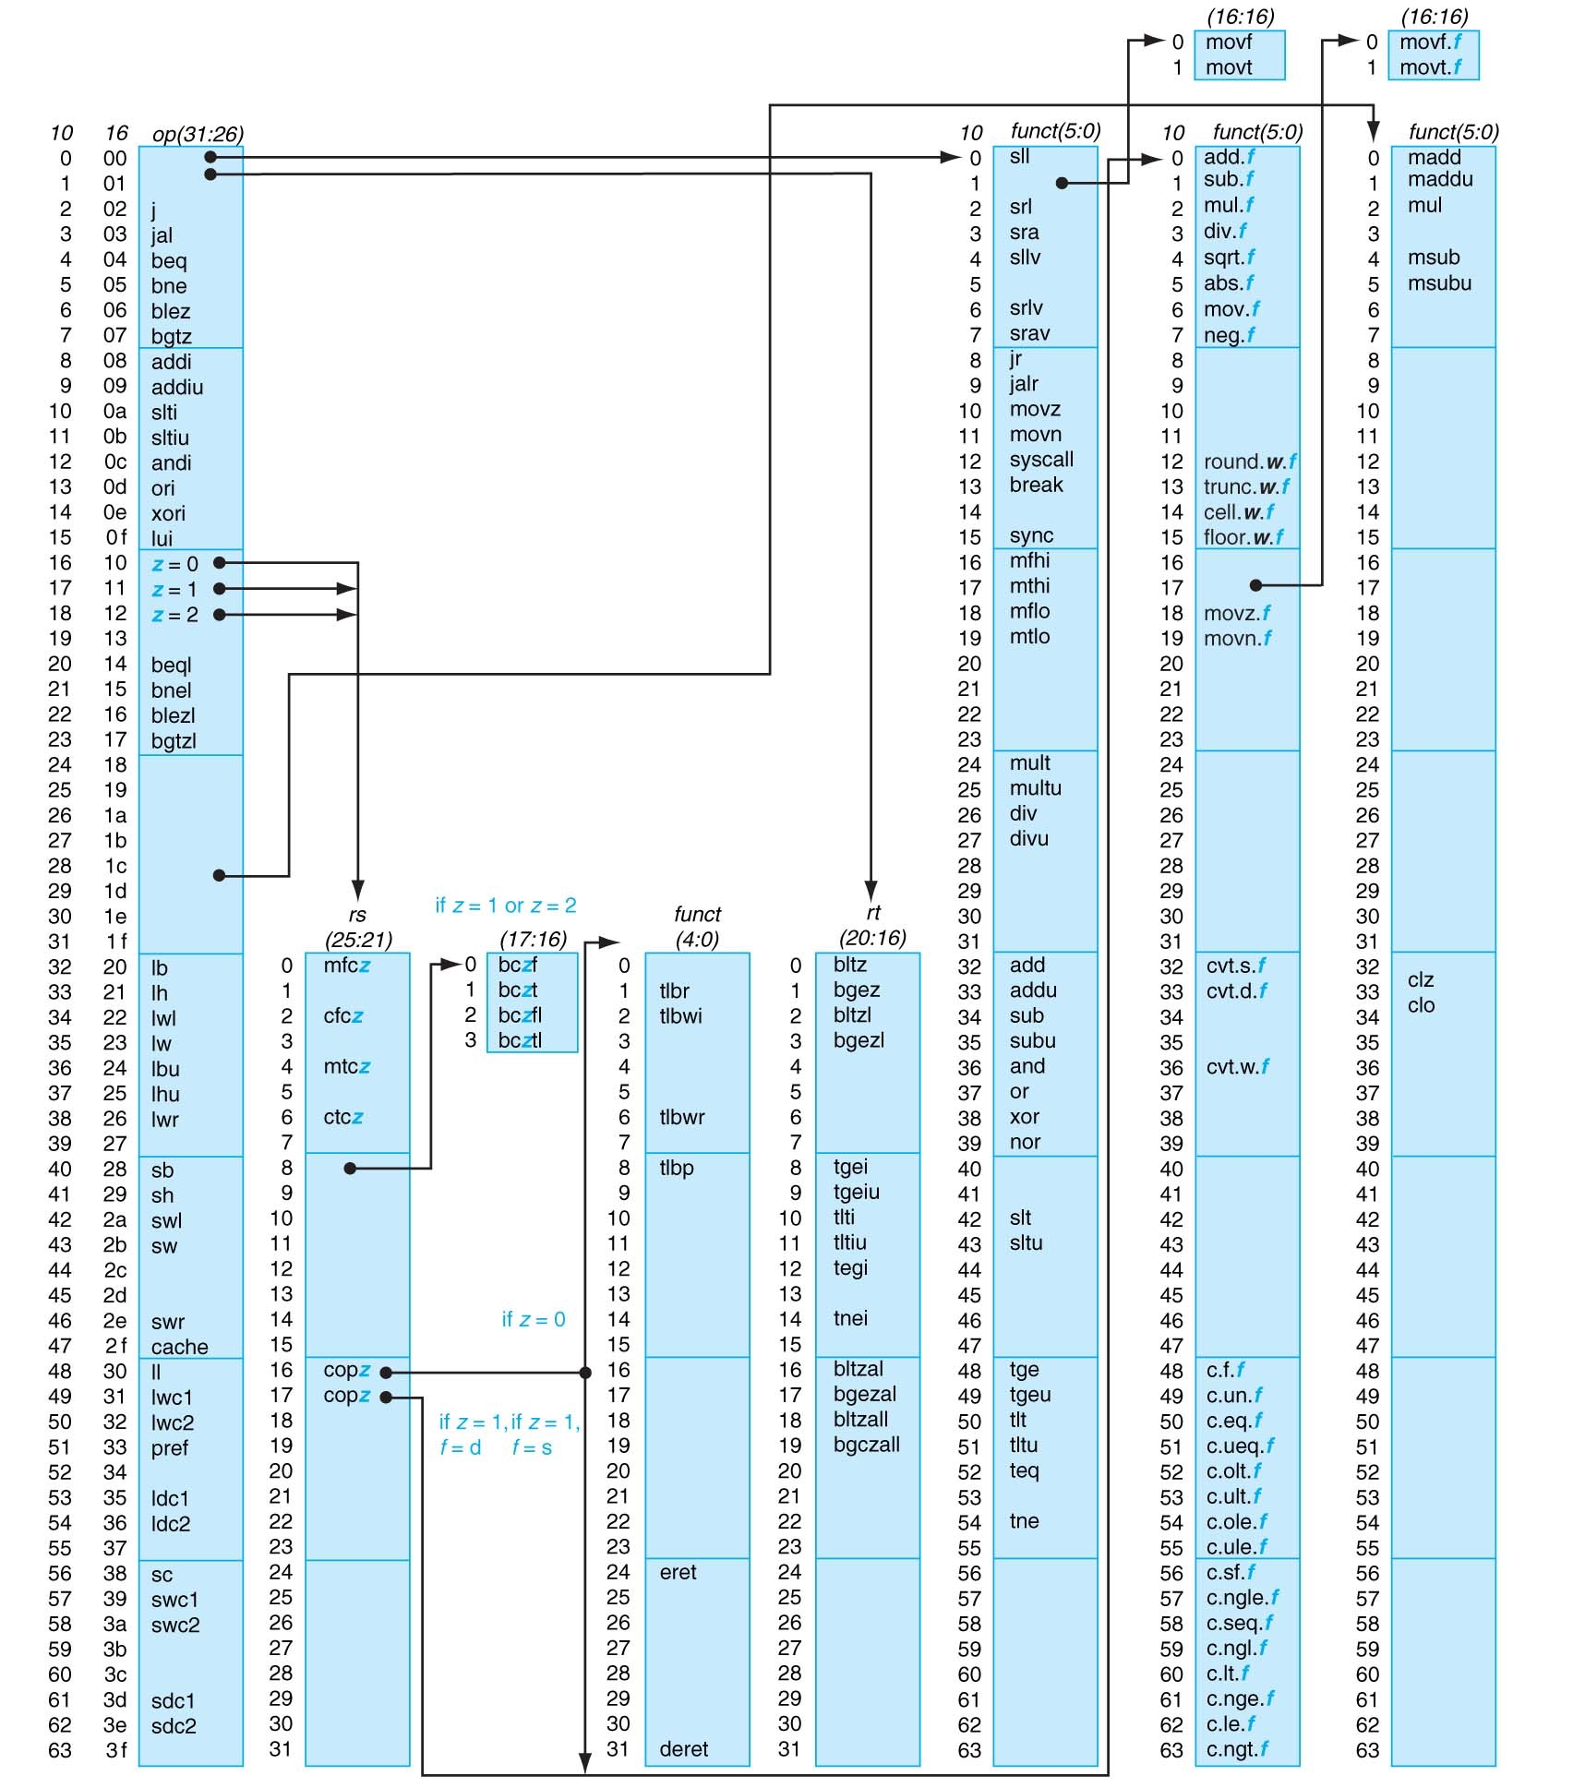
MIPS opcode map
Appendix A-50

Slide 14
slti/sltiu : I-format instruction
op
rs
rt
constant or address
6 bits
5 bits
5 bits
16 bits
slti $16, $19, 0
001010 10011 10000 0000000000000000
0010 1010 0111 0000 0000 0000 0000 0000
= 0x2A700000

Slide 15
Compiling Loop Statements
C code:
i = 1;
while (arr[i] == k) i++;
i in $s3, k in $s5, address of arr in $s6
Compiled MIPS code:
Loop: sll $t1, $s3, 2 # $t1 = 4*i add $t1, $t1, $s6 # $t1 = &arr[i] lw $t0, 0($t1) # $t0 = arr[i] bne $t0, $s5, Exit addi $s3, $s3, 1 # i++ j Loop Exit: …

Slide 16
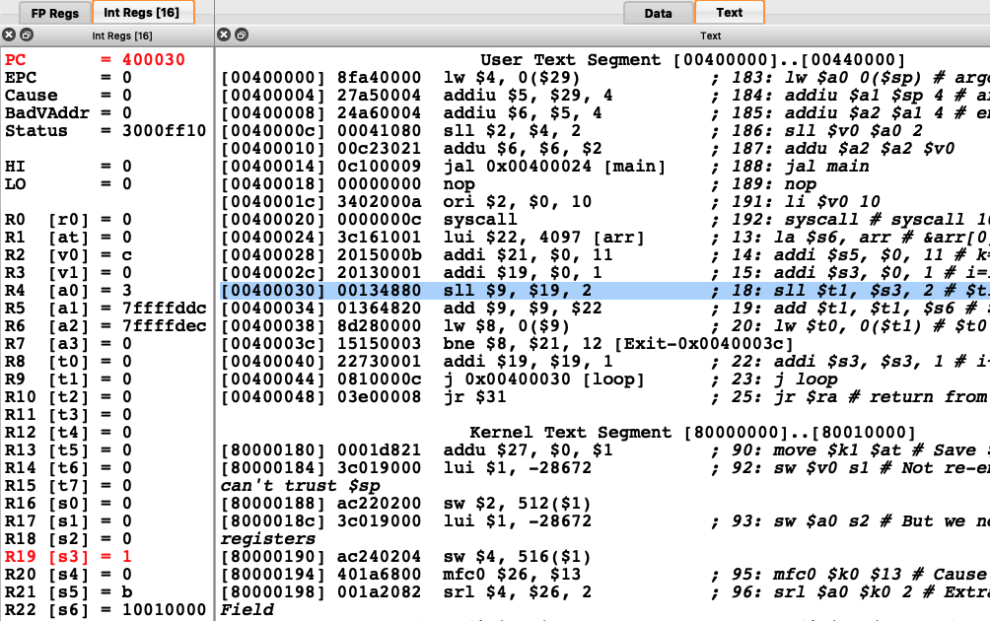

Slide 17
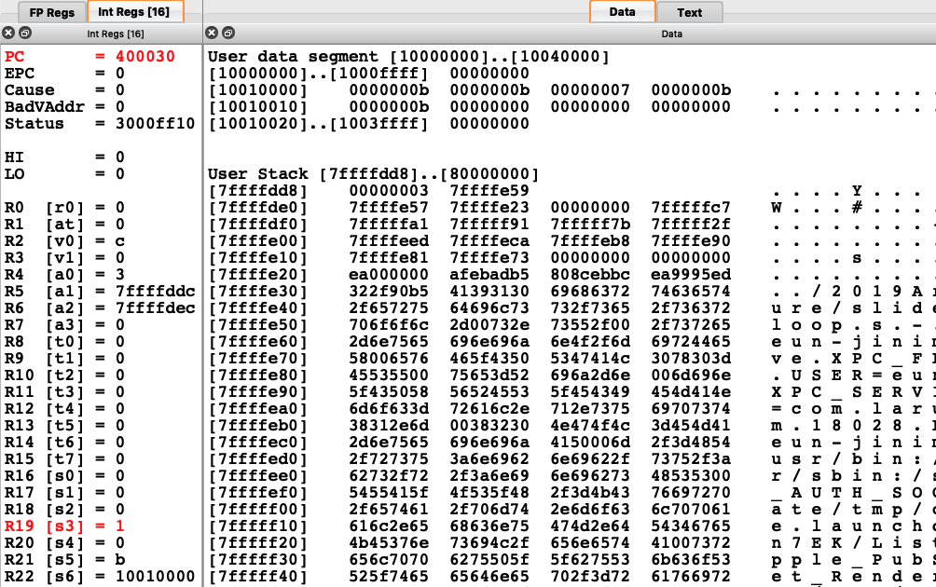
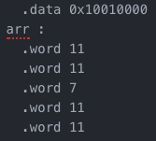

Slide 18
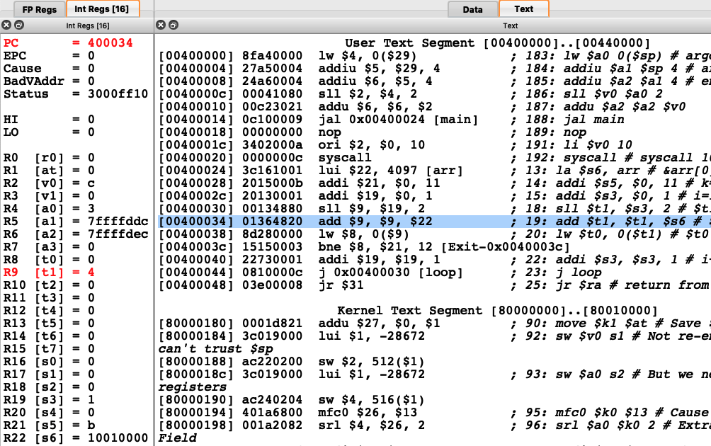

Slide 19
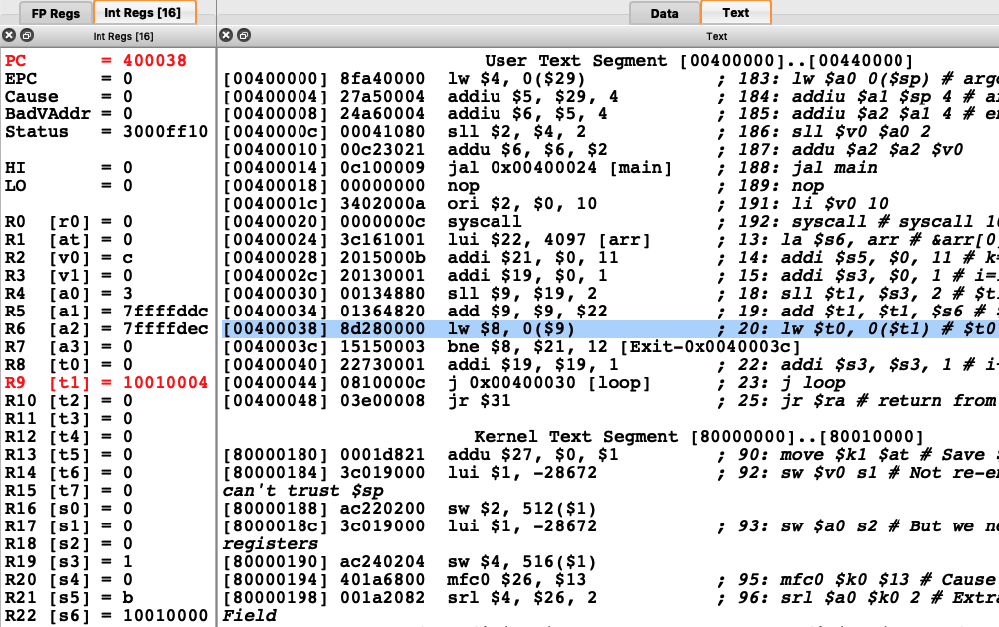

Slide 20
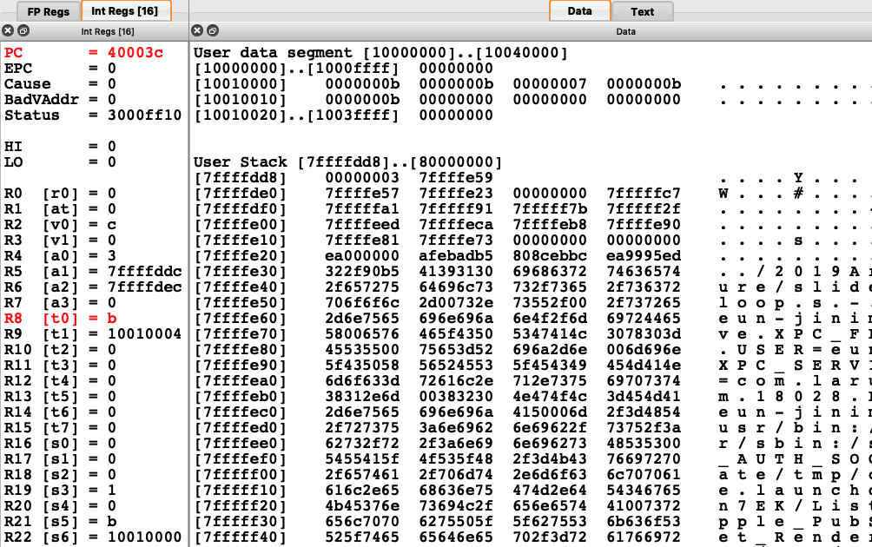

Slide 21
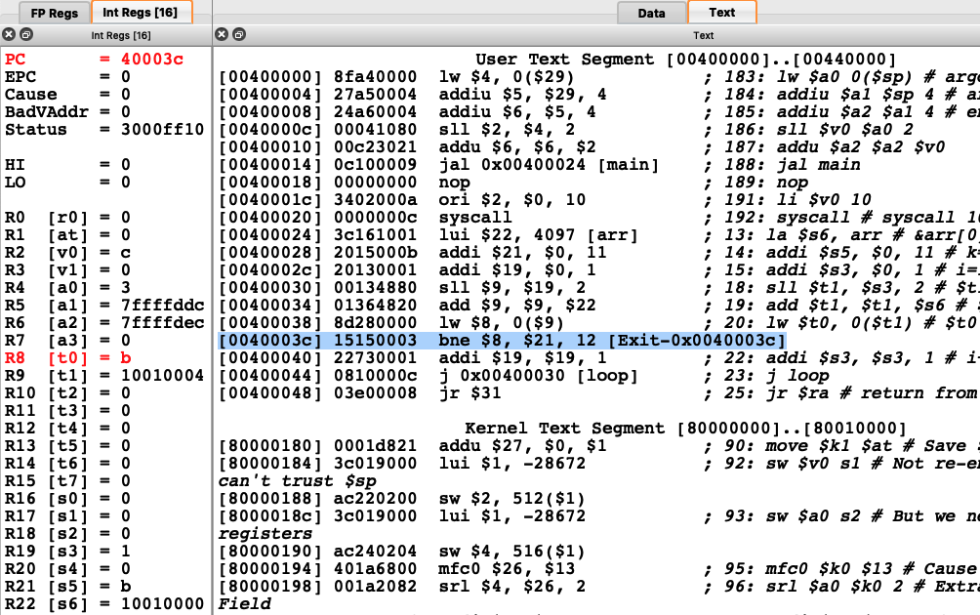

Slide 22
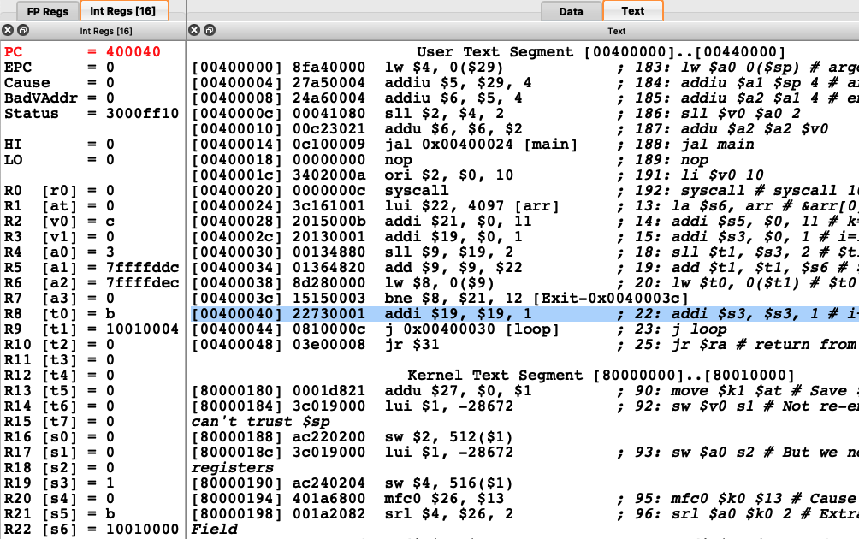

Slide 23
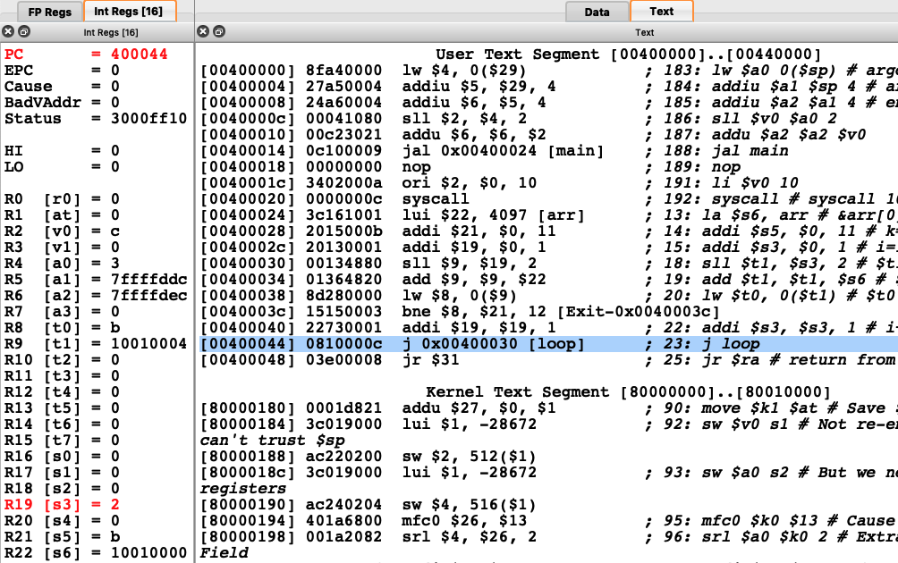

Slide 24
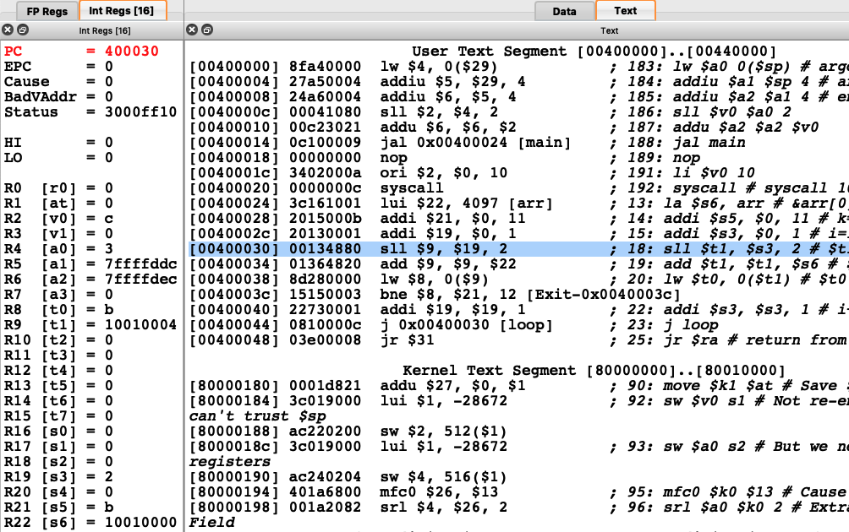

Slide 25
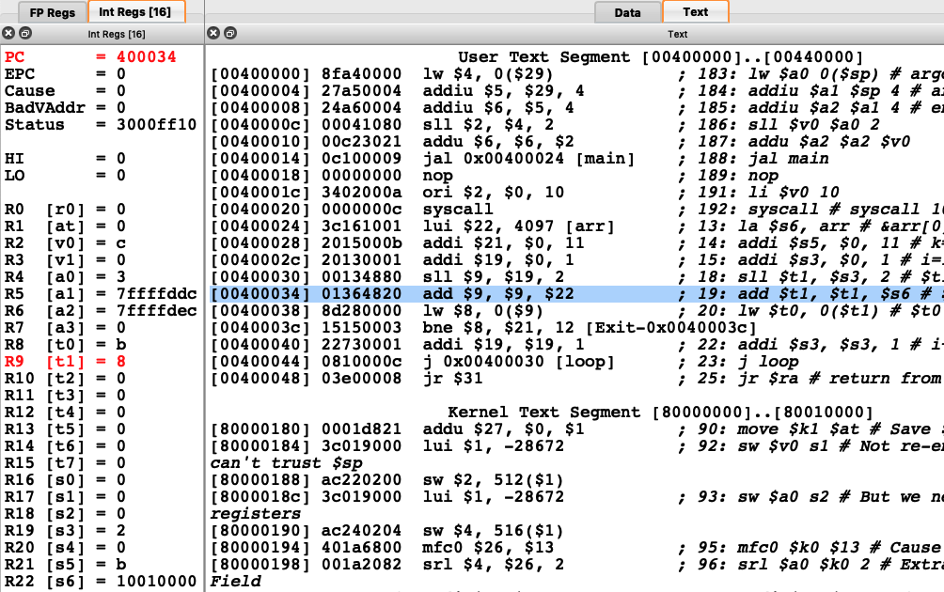

Slide 26


Slide 27


Slide 28


Slide 29


Slide 30
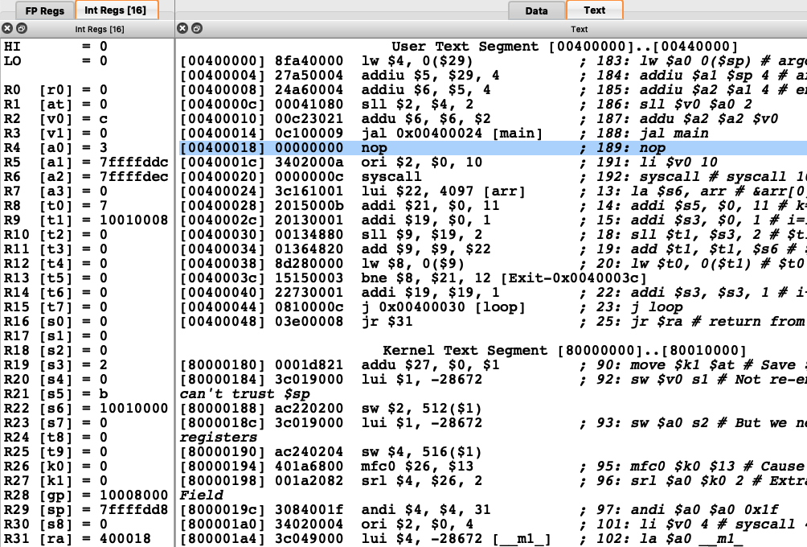

Slide 31
Branch example
Memory addresses
Memory contents
bne $2,$3,L1 [0x0040 0024] 000101 00010 00011 0000 0000 0000 0010
add $4,$5,$6 [0x0040 0028] 000000 00101 00110 00100 00000 100000
L1: lw $7,4($16) [0x0040 002C] 100011 10000 00111 0000 0000 0000 0100
L2: sw $7,-4($16) [0x0040 0030] 101011 10000 00111 1111 1111 1111 1100
j L3 [0x0040 0034] 000010 00 0001 0000 0000 0000 0001 0000
beq $2,$3,L2 [0x0040 0038] 000100 00010 00011 1111 1111 1111 1110
sub $6,$4,$5 [0x0040 003C] 000000 00100 00101 00110 00000 100010
L3: [0x0040 0040]
L1 from bne : 0000 0000 0100 0000 0000 0000 0010 0100
+ ???? ???? ???? ??00 0000 0000 0000 1000 (?=0)
0000 0000 0100 0000 0000 0000 0010 1100
L3 from j : 0000 00 0001 0000 0000 0000 0001 0000 00 4의 배수
L2 from beq : 0000 0000 0100 0000 0000 0000 0011 1000
+ ???? ???? ???? ??11 1111 1111 1111 1000 (?=1)
0000 0000 0100 0000 0000 0000 0011 0000

Slide 32
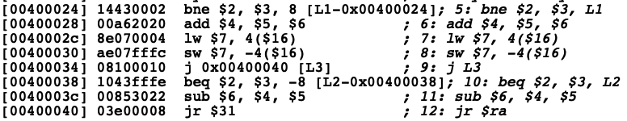

Slide 33
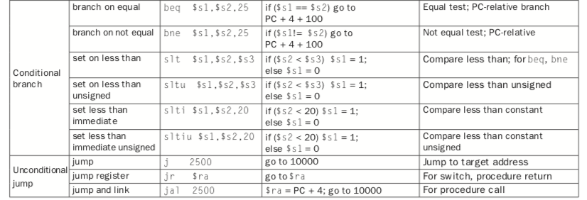

Slide 34
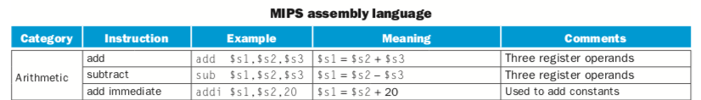
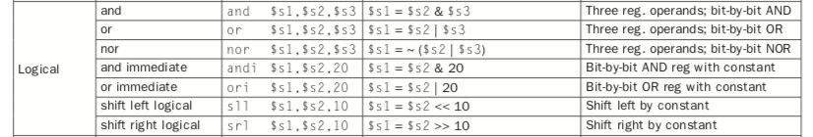
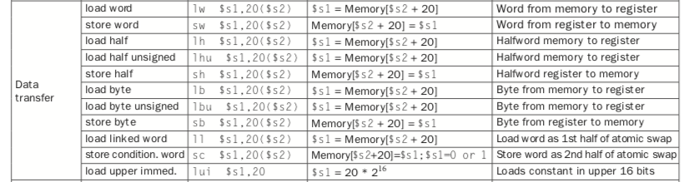

Slide 35
Representing Addresses in Branches and Jumps
Instructions:
bne $t4,$t5,Label Next instruction is at Label if $t4!= $t5
beq $t4,$t5,Label Next instruction is at Label if $t4 = $t5
j Label Next instruction is at Label
Instruction Formats:
Addresses are not 32 bits hint: How did we handle this with load and store instructions?
op rs rt 16 bit address
I
J
op 26 bit address

Slide 36
Representing Branch Target Address
Instructions:
bne $t4,$t5,Label Next instruction is at Label if $t4!=t5
beq $t4,$t5,Label Next instruction is at Label if $t4=$t5
Instruction Formats:
Could specify a register (like lw and sw) and add it to address
use Instruction Address Register (PC = program counter)
most branches are local (principle of locality)
address offsets are always multiples of 4
Branch Target Address of bne,beq instruction = ($PC) + 4 x offset
Jump instructions just use high order bits of PC
address boundaries of 256 MB
Branch Target Address of j instruction = PC(31:28) | 4 x offset
op rs rt 16 bit address
I

Slide 37
Branch Addressing
Branch instructions specify
Opcode, two registers, target address
Most branch targets are near branch
Forward or backward
op
rs
rt
constant or address
6 bits
5 bits
5 bits
16 bits
PC-relative addressing
Target address = PC + offset × 4
PC already incremented by 4 by this time

Slide 38
Jump Addressing
Jump (j and jal) targets could be anywhere in text segment
Encode full address in instruction
op
address
6 bits
26 bits
(Pseudo)Direct jump addressing
Target address = PC_{31…28} : (address × 4)

Slide 39
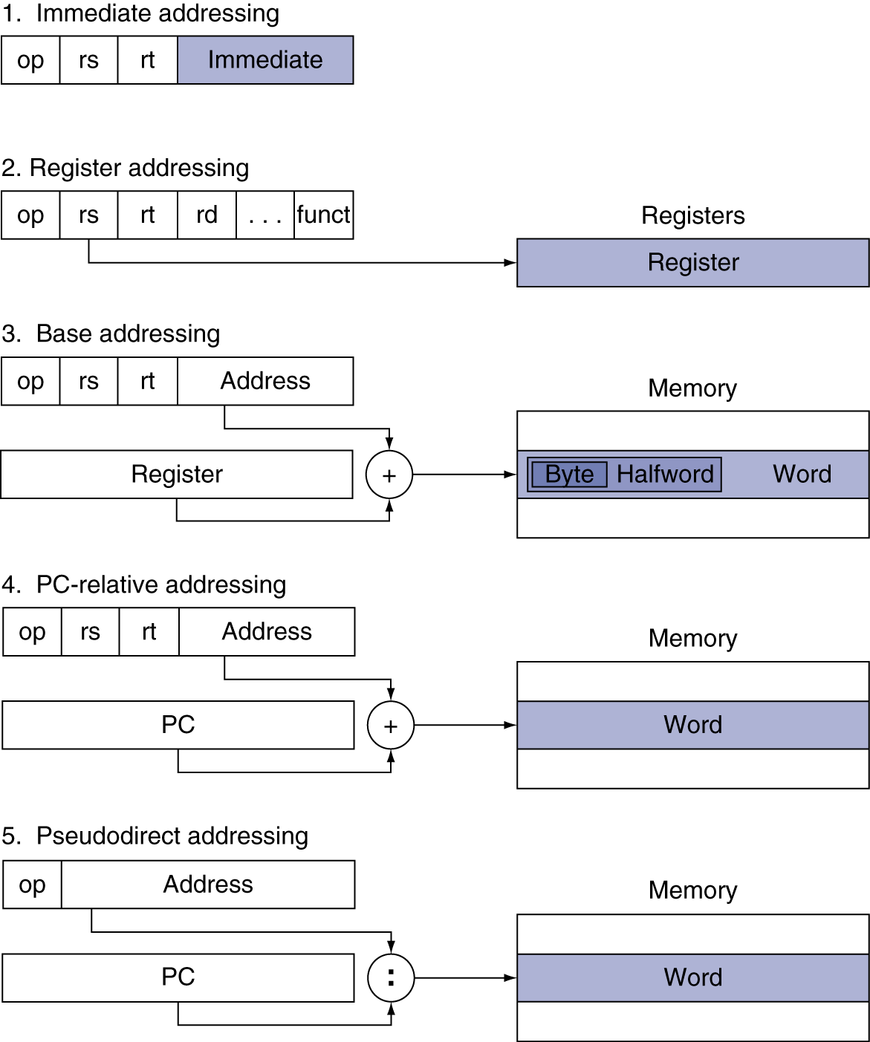
2.9 Addressing Mode Summary

Slide 40
Summary of basic instructions
Instruction Meaning add $s1,$s2,$s3 $s1 = $s2 + $s3 sub $s1,$s2,$s3 $s1 = $s2 - $s3 lw $s1,100($s2) $s1 = Memory[$s2+100] sw $s1,100($s2) Memory[$s2+100] = $s1 bne $s4,$s5,L Next instr. is at Label if $s4 !=$s5 beq $s4,$s5,L Next instr. is at Label if $s4 = $s5 j Label Next instr. is at Label
3 MIPS Instruction Formats:
op rs rt rd shamt funct
R
I
J
op rs rt 16 bit address
op 26 bit address

Slide 41
HW3 : due 10/7 Monday 11:00AM
다음의 프로그램을 작성하여 SPIM 에 로드하여 실행해 보고
프로그램이 하는 일을 c 언어로 표현하라.
nop 를 제외한 명령어 12개를 모두 2진수로 표현하고 R,I,J format 중 어느 format 인지 설명하고 field 별로 나누어 그 의미를 설명하라. (MIPS opcode map 참조)
숙제 제출은 ecampus 에 직접 작성으로 에디터에 작성하되 그림 파일은 절대로 첨부하지 말 것. (그림 첨부 시 0점 처리)

Slide 42
.data 0x10010000
a:
.word 30
.word 50
.word -10
.word 45
.word 100
.text
.globl main
main: lui $s0, 0x1001
addi $s1, $0, 5
add $t0, $0, $0
add $s2, $0, $0
for: slt $t1, $t0, $s1
beq $t1, $0, end
lw $t2, 0($s0)
add $s2, $s2, $t2
addi $t0, $t0, 1
addi $s0, $s0, 4
j for
end: nop
jr $ra

Slide 43
Assembler Pseudoinstructions
Most assembler instructions represent machine instructions one-to-one
Pseudoinstructions: figments of the assembler’s imagination
move $t0, $t1 → add $t0, $zero, $t1
blt $t0, $t1, L → slt $at, $t0, $t1 bne $at, $zero, L
$at (register 1): assembler temporary

Slide 44
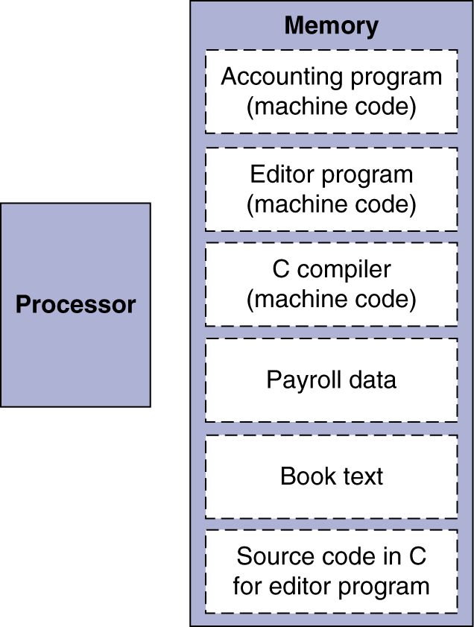
Stored Program Computers
The BIG Picture
Instructions represented in binary, just like data
Instructions and data stored in memory
Programs can operate on programs
e.g., compilers, linkers, …
Program is a sequence of instructions
Processor fetches and executes instructions from memory in sequence.

